Slide 1
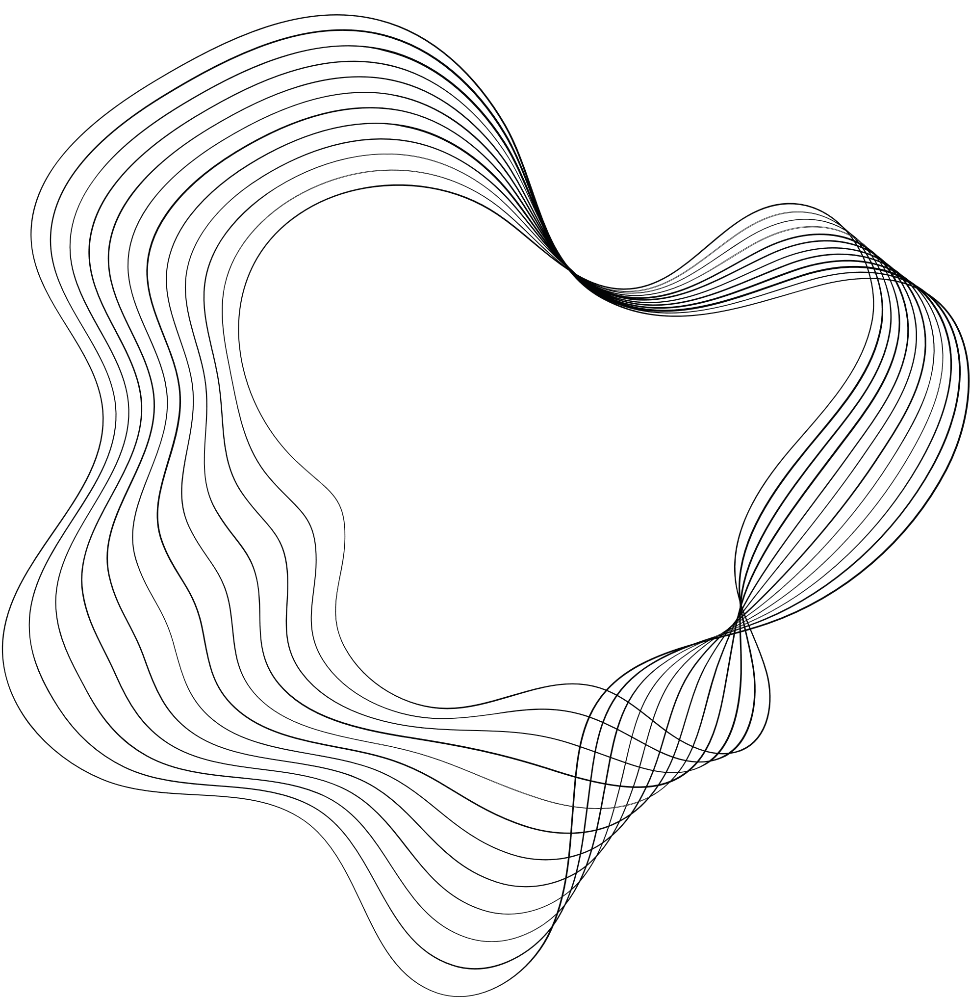

PROJECT
WALLPAPER GROUPS IN THE MATHEMATIKON
CAROLINE, JOHANNES, SEBASTIAN

Slide 2
CLASSIFICATION
P or C
numbers
m and g
P: oblique, rectangular, square, hexagonal
C: centred rectangular
2: 180° turn (half-turn)
3: 120°
4: 90° turn
6: 60° turn
m: mirror (reflection line)
g: glide reflection
mm: mirrors in 2 directions
gg: glide reflections in 2 directions

Slide 3
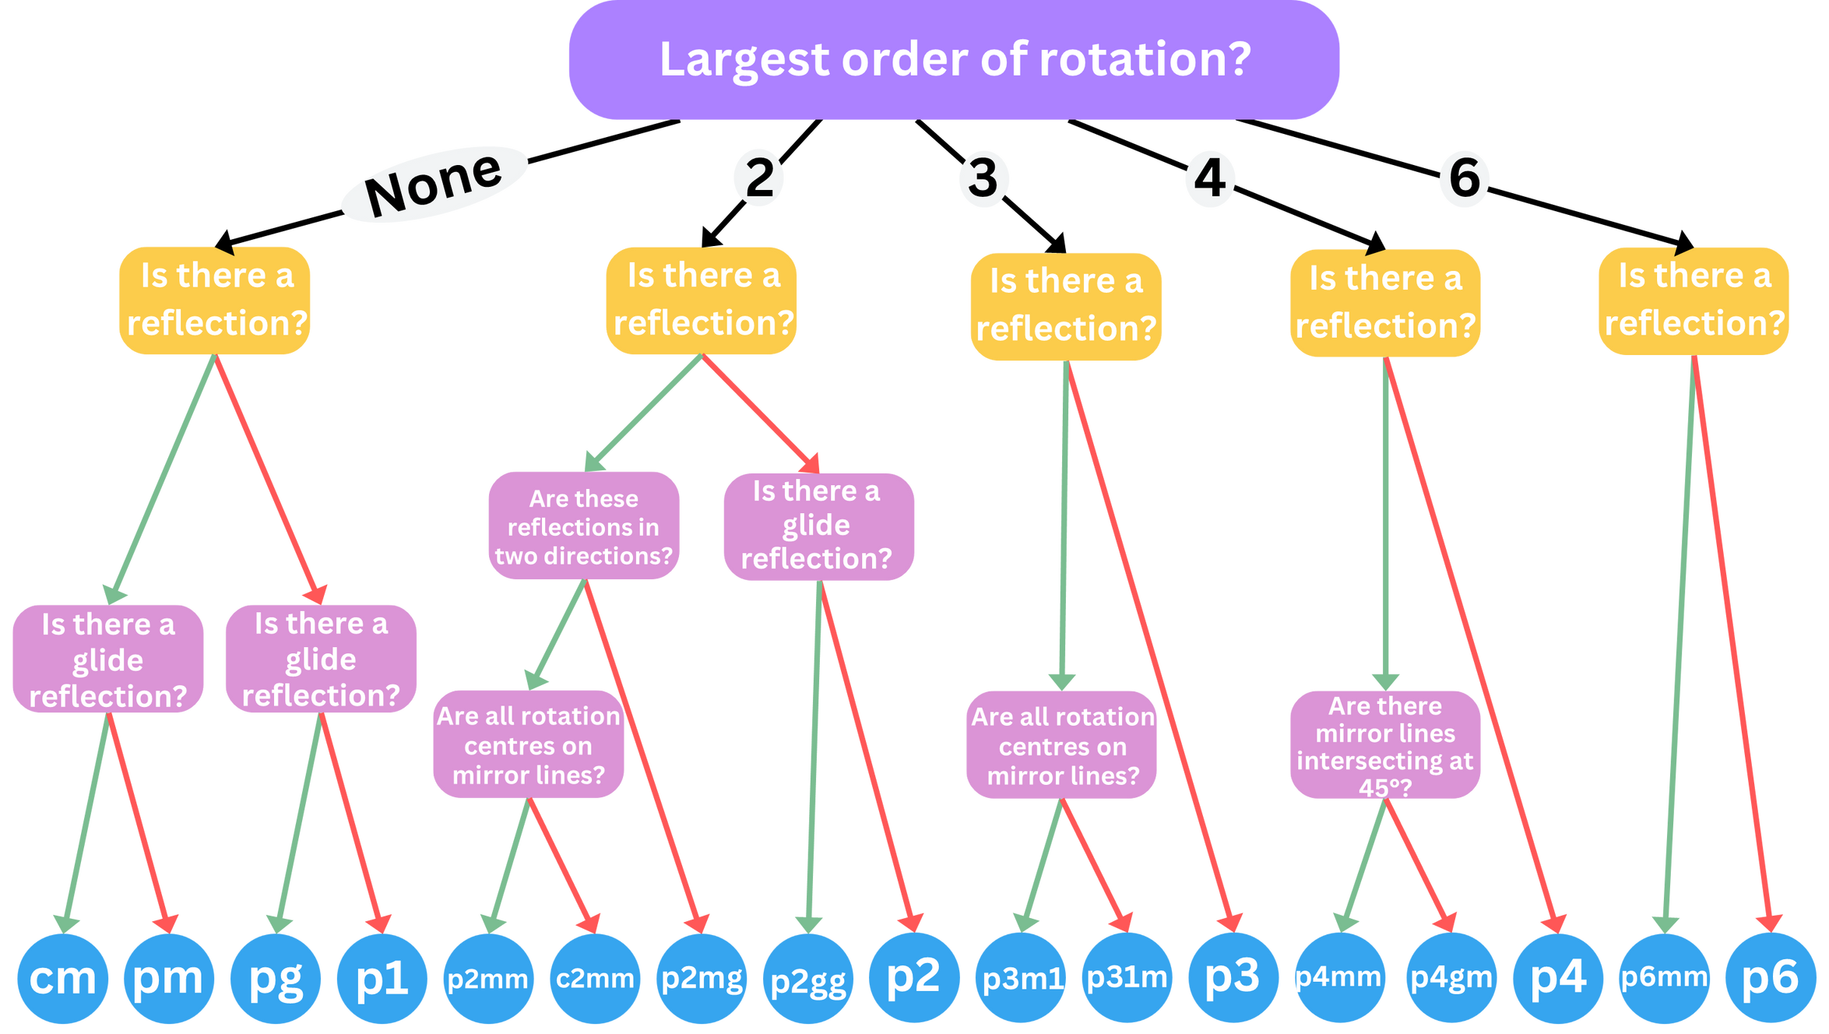

Slide 4
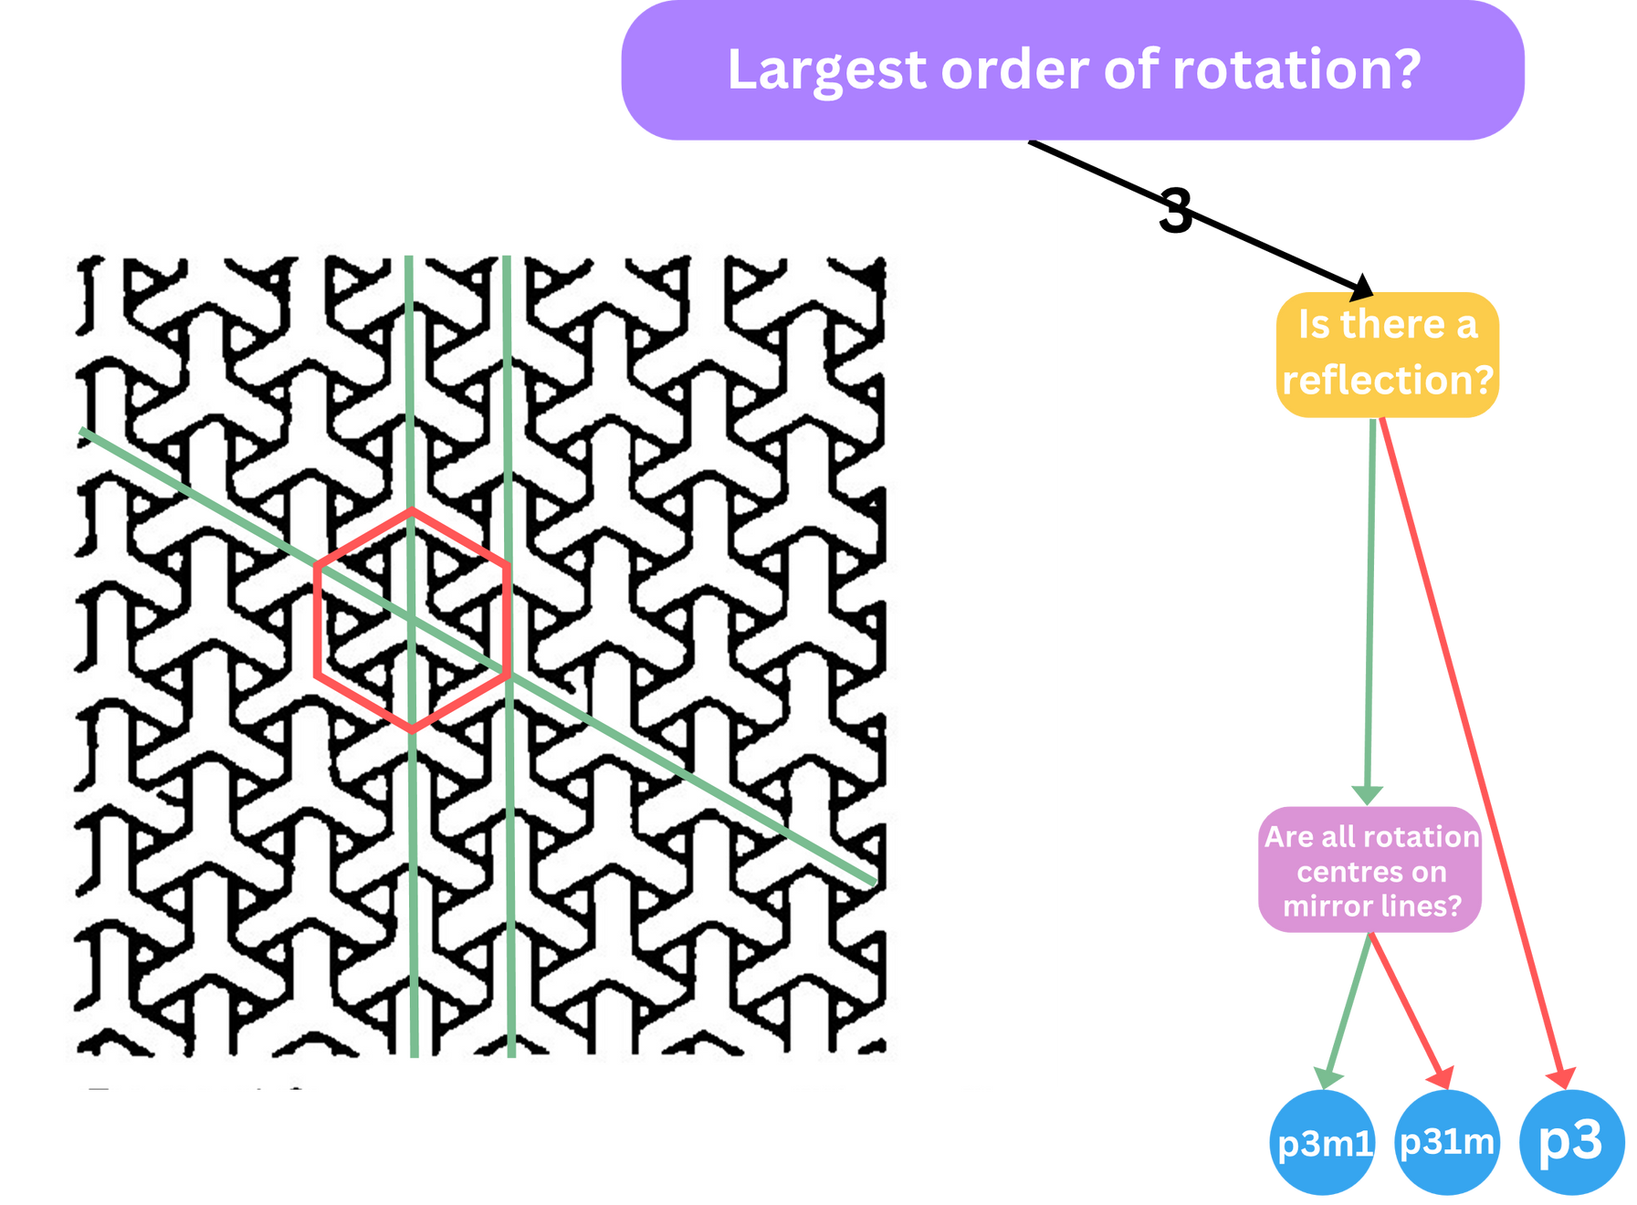

Slide 5
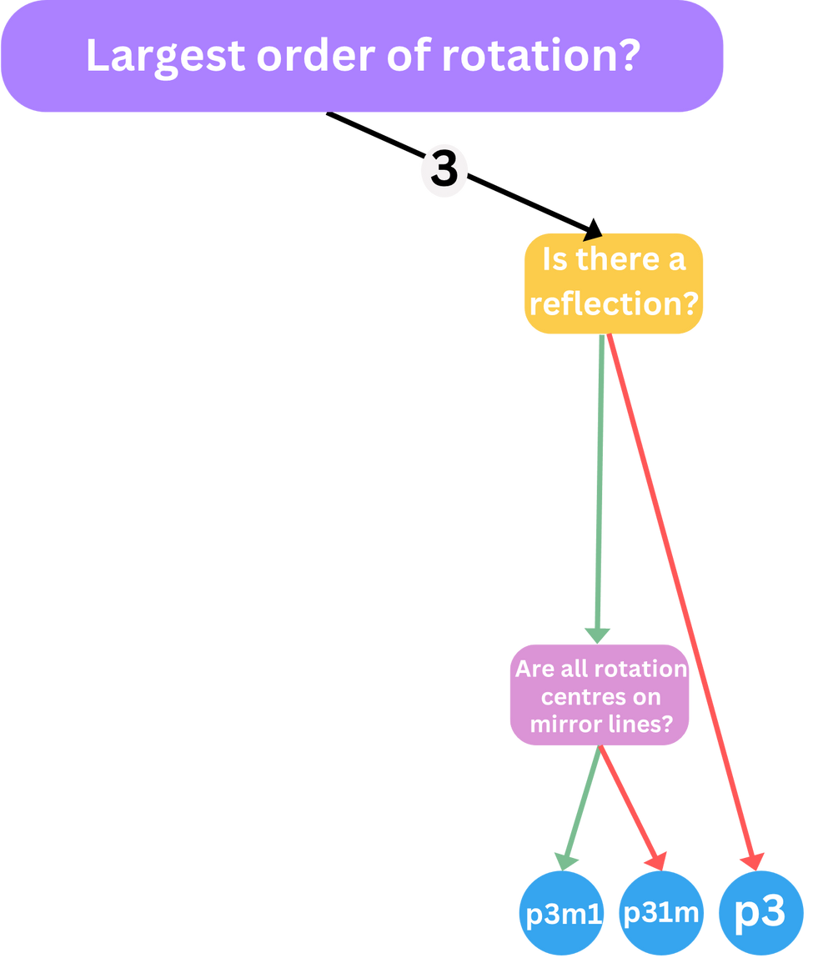

Slide 6
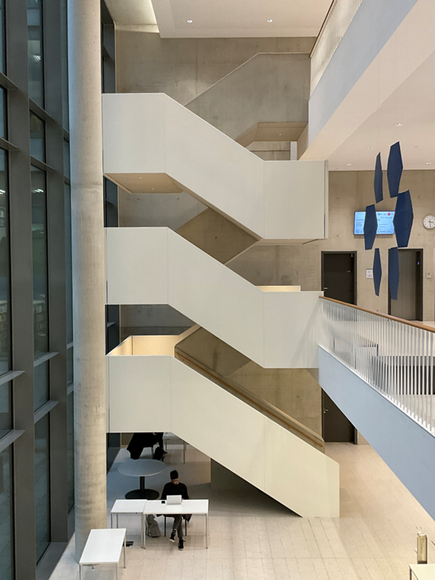
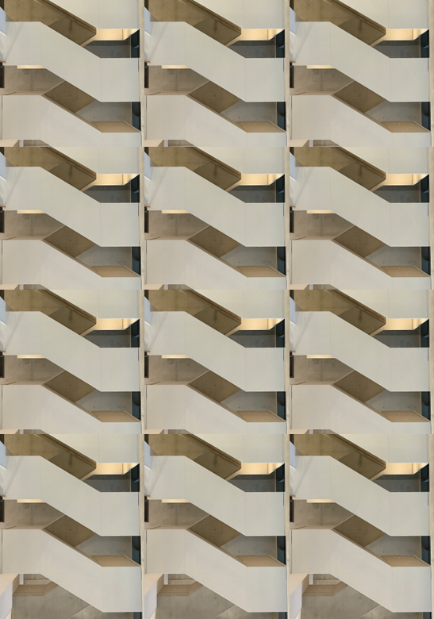
OBLIQUE
P1 P2
P1

Slide 7
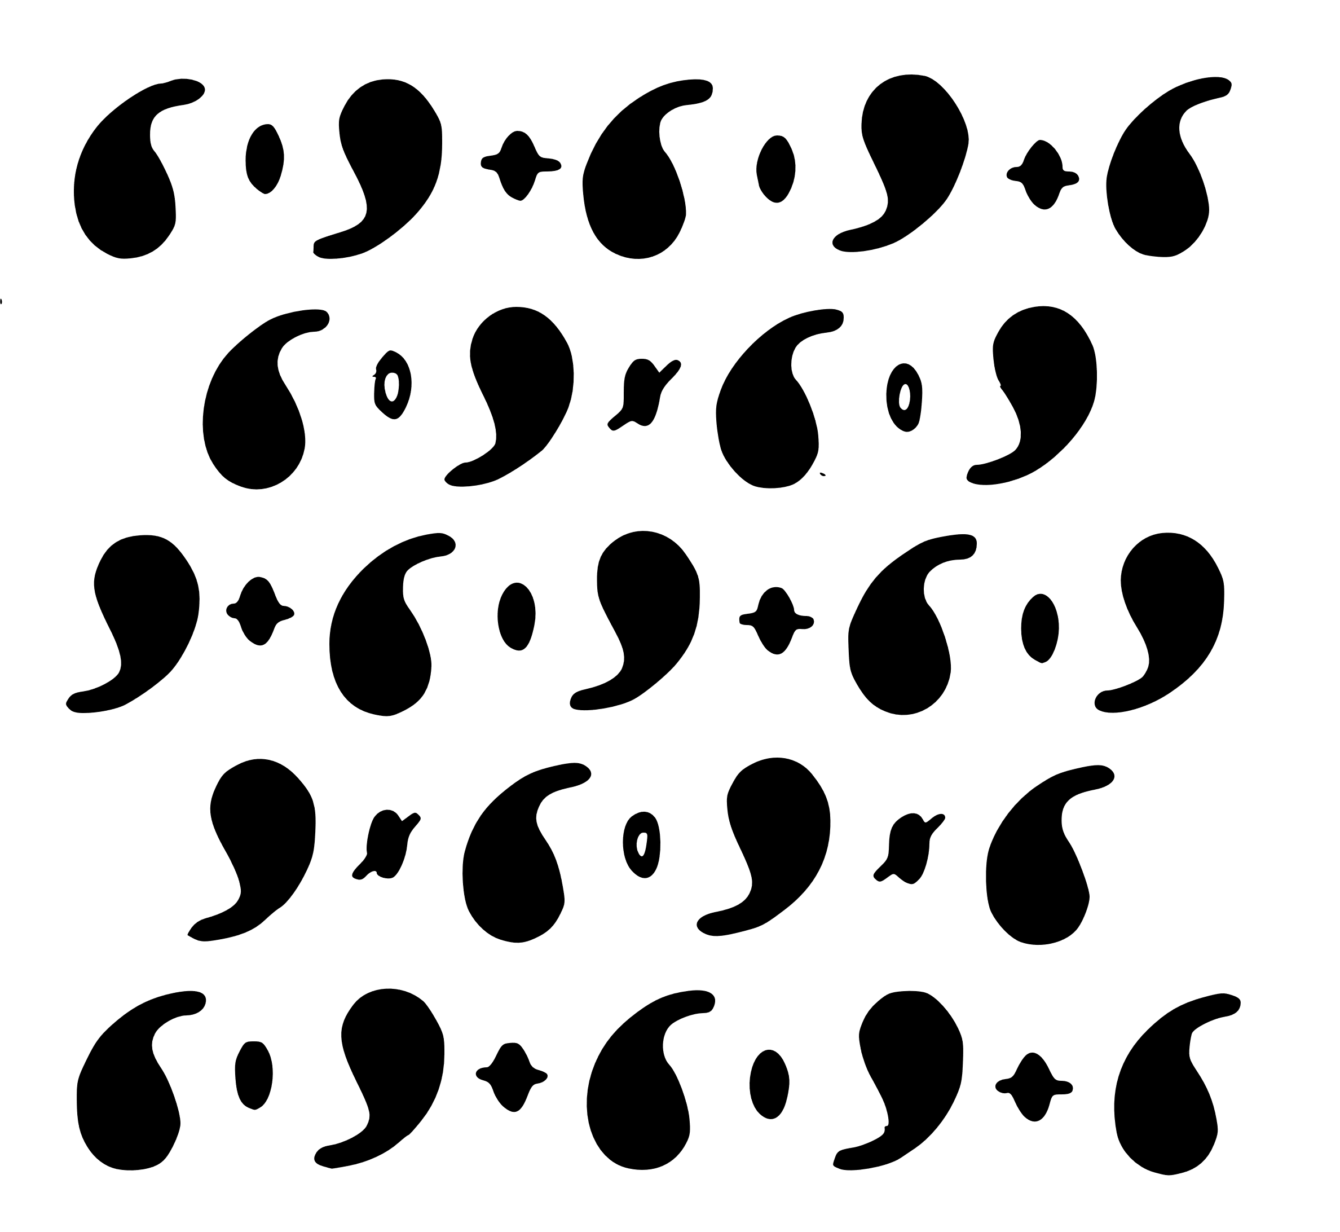
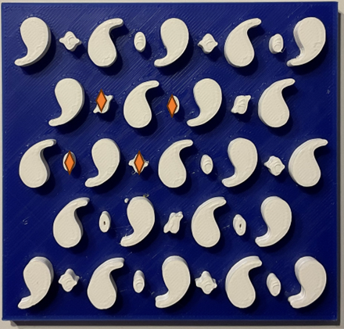

OBLIQUE
P1 P2
P2

Slide 8
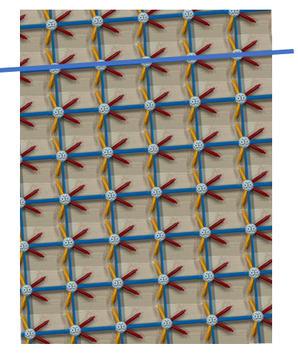
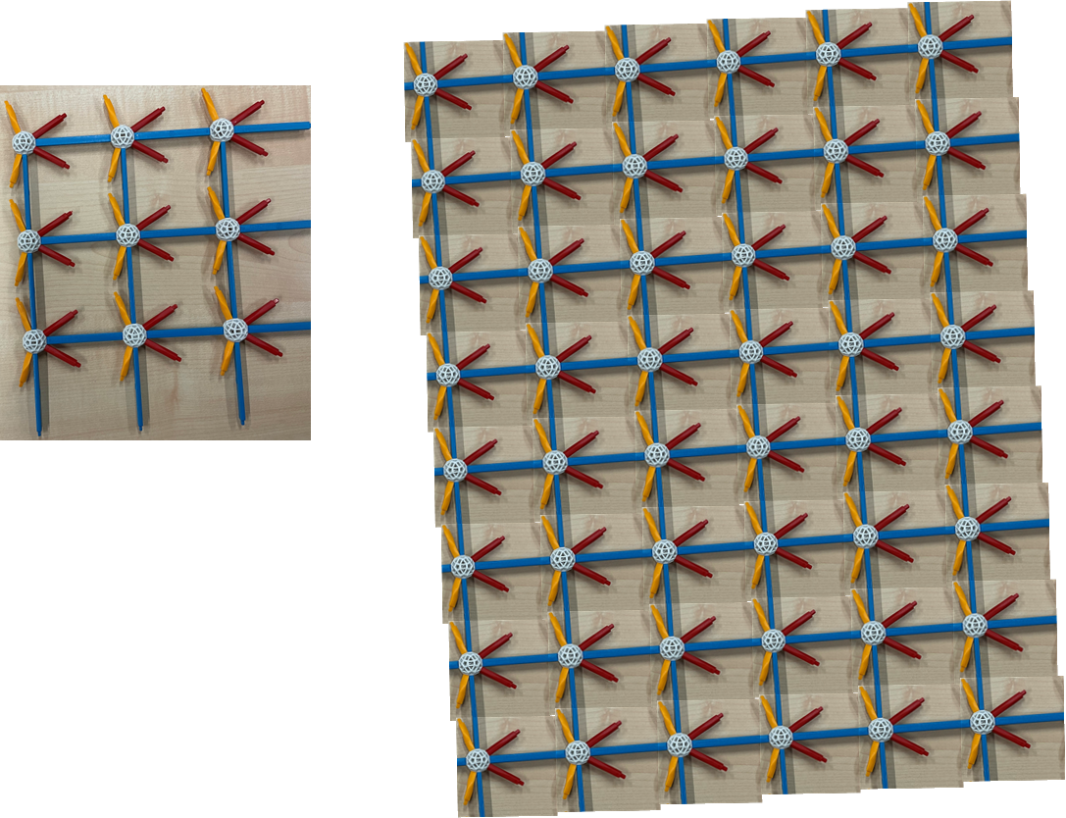
RECTANGULAR
PM PG P2MM P2MG P2GG
PM

Slide 9
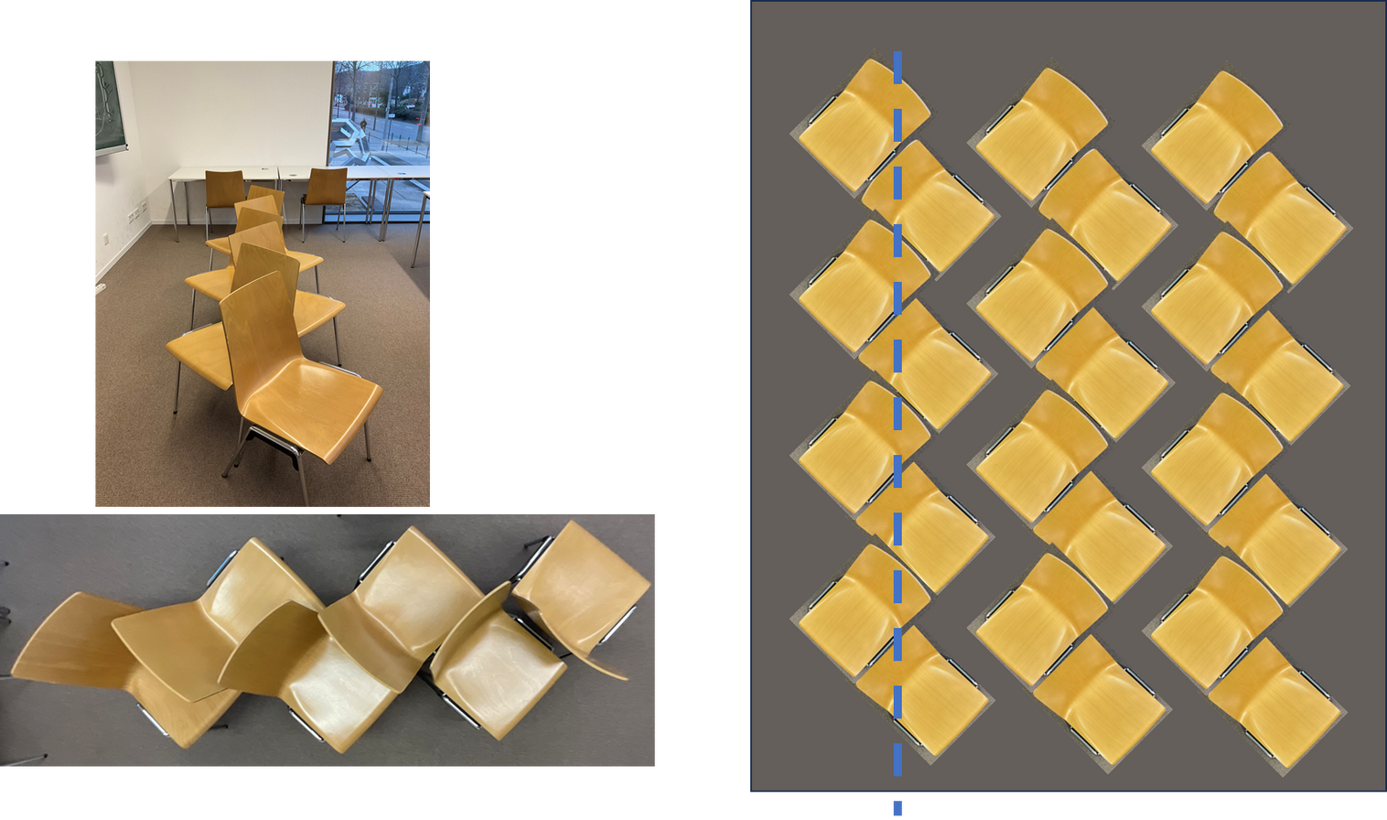
RECTANGULAR
PM PG P2MM P2MG P2GG
PG

Slide 10
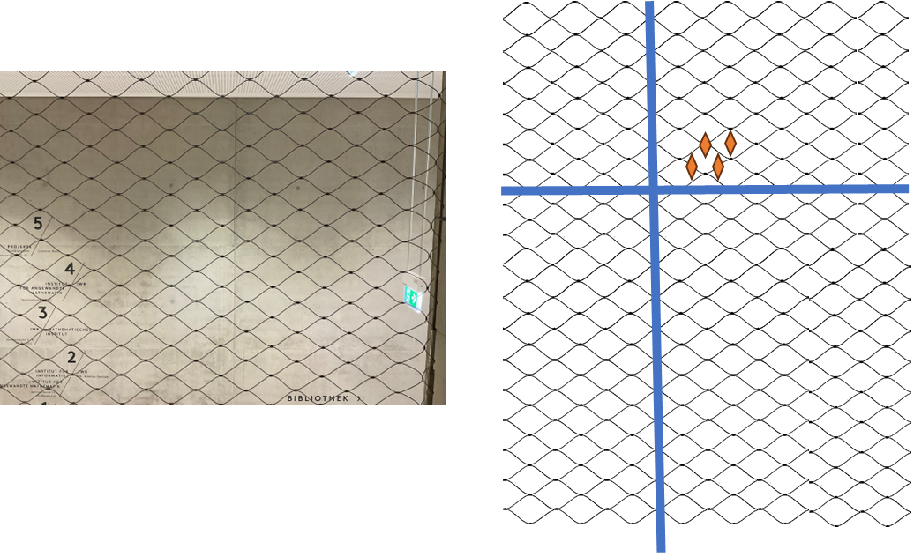
RECTANGULAR
PM PG P2MM P2MG P2GG
P2MM

Slide 11
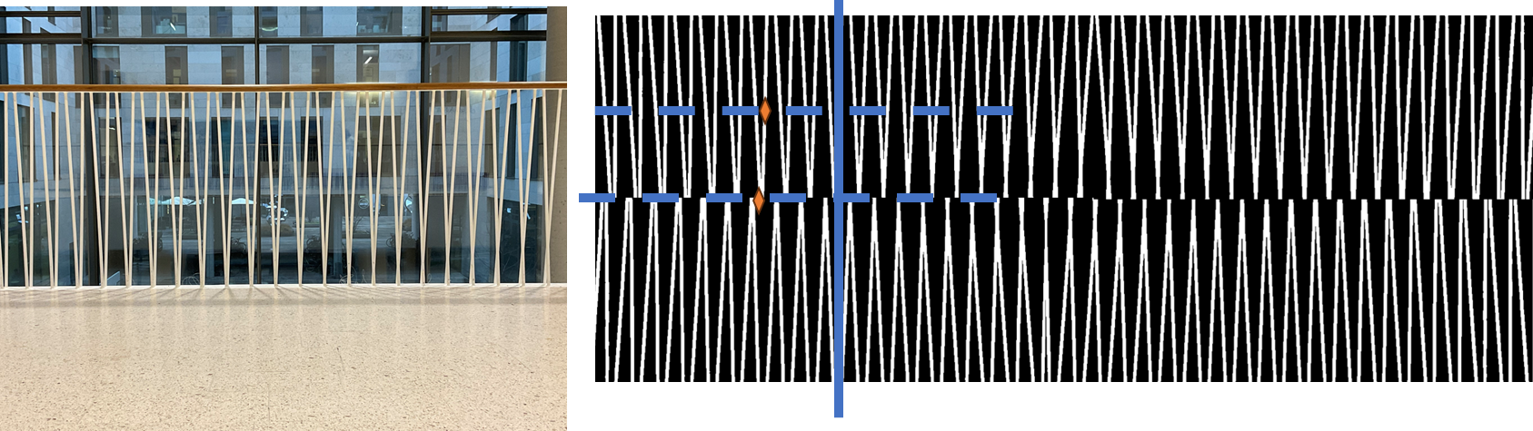
RECTANGULAR
PM PG P2MM P2MG P2GG
P2MG

Slide 12
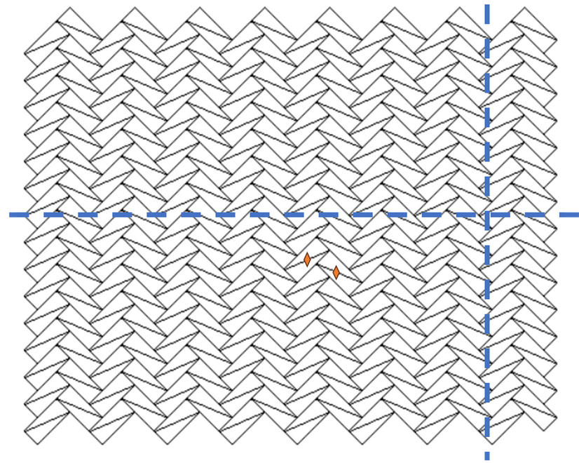
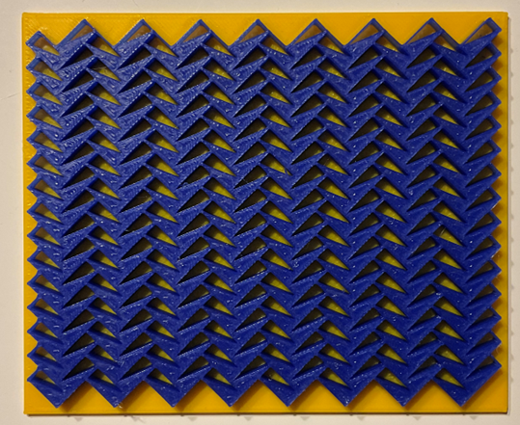
RECTANGULAR
PM PG P2MM P2MG P2GG
P2GG

Slide 13
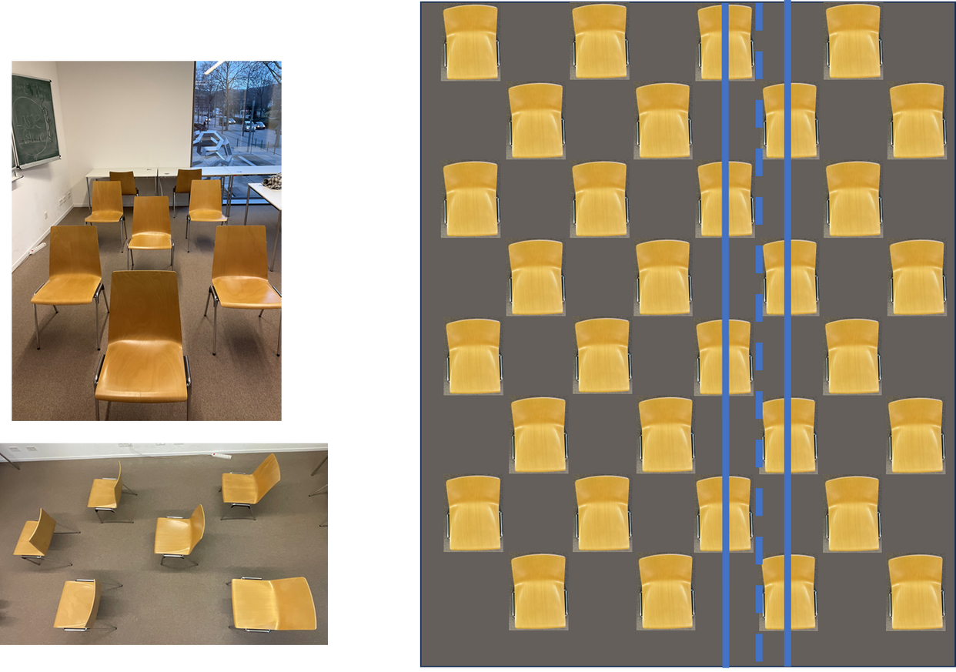
CENTRED
RECTANGULAR
CM C2MM
CM

Slide 14
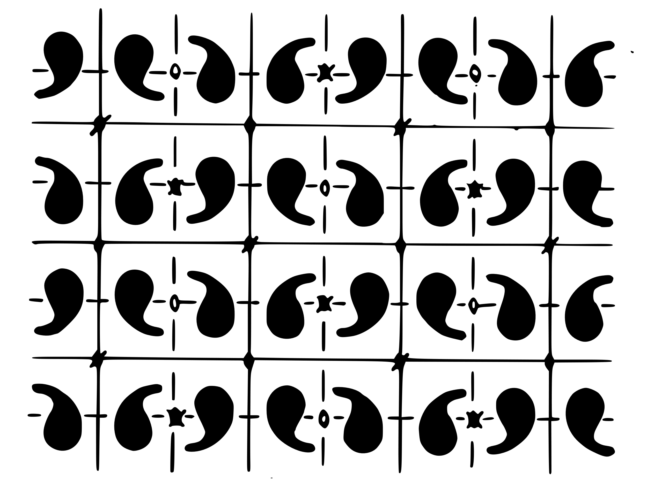
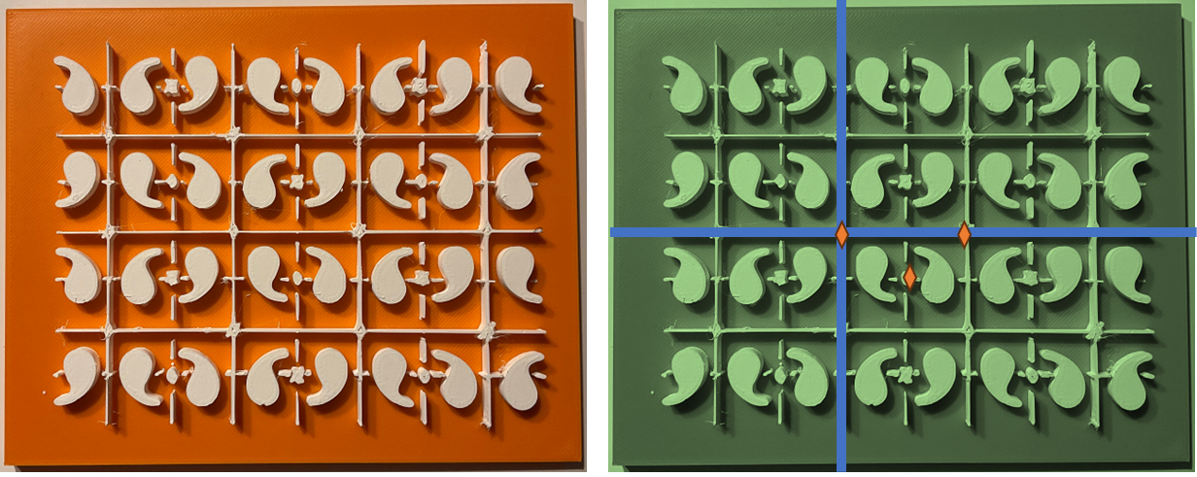
CENTRED
RECTANGULAR
CM C2MM
C2MM

Slide 15
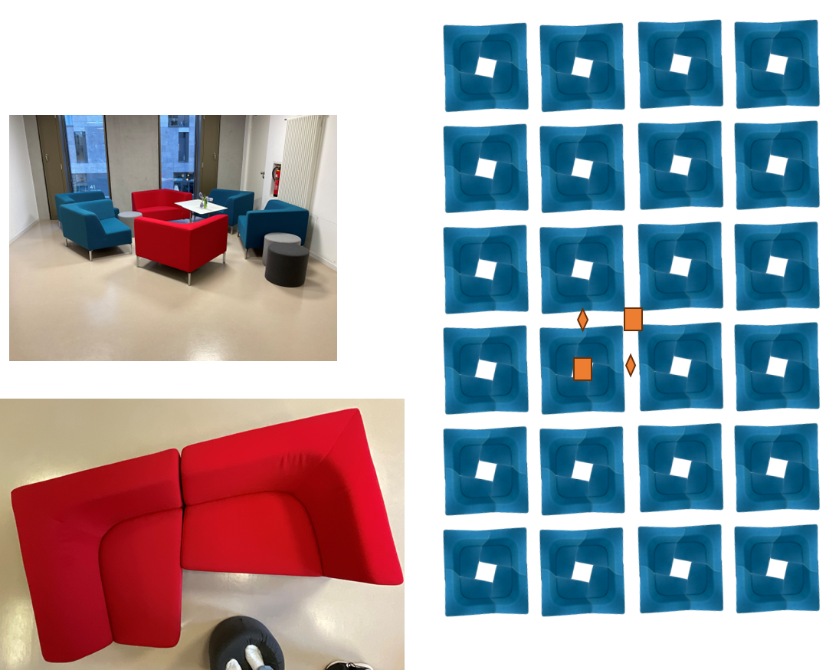
SQUARE
P4 P4MM P4GM
P4

Slide 16
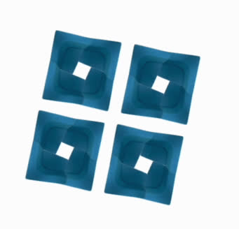
ANIMATION P4

Slide 17
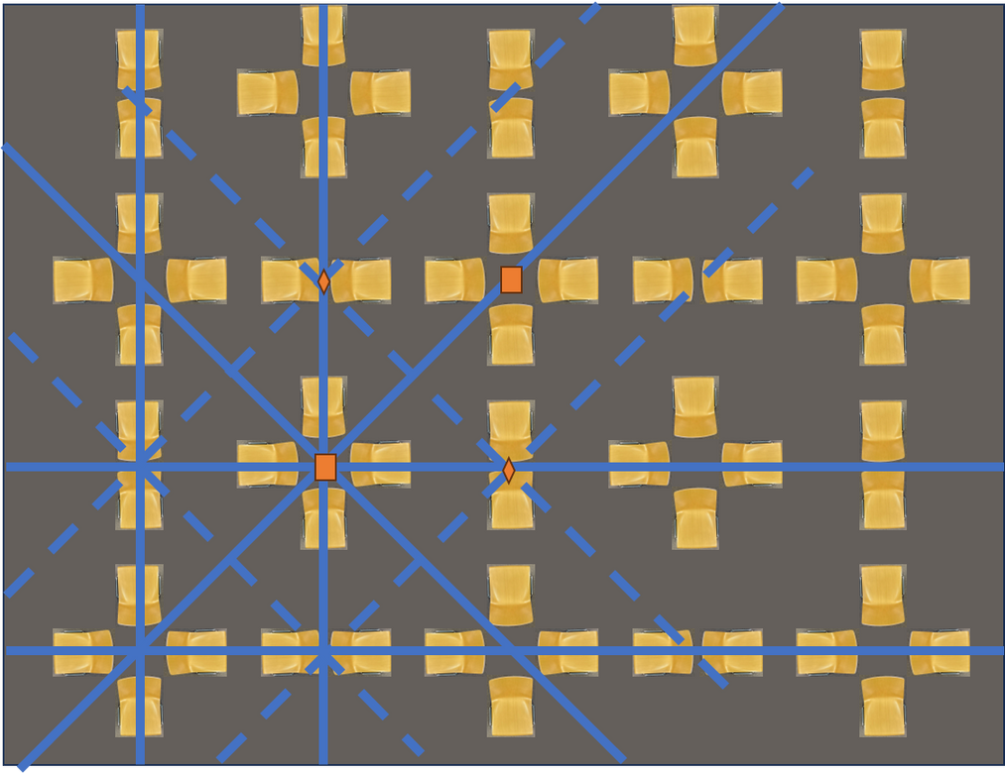
SQUARE
P4 P4MM P4GM
P4MM

Slide 18
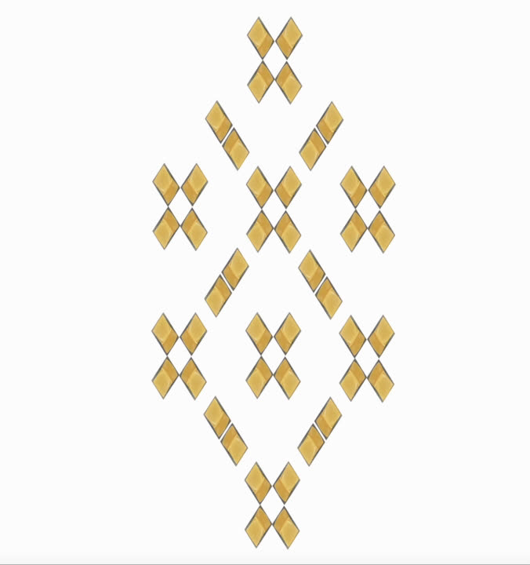
ANIMATION P4MM

Slide 19
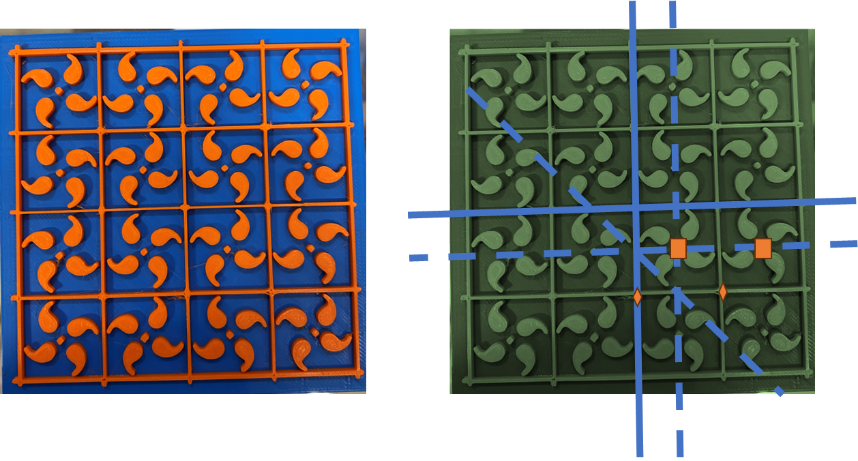
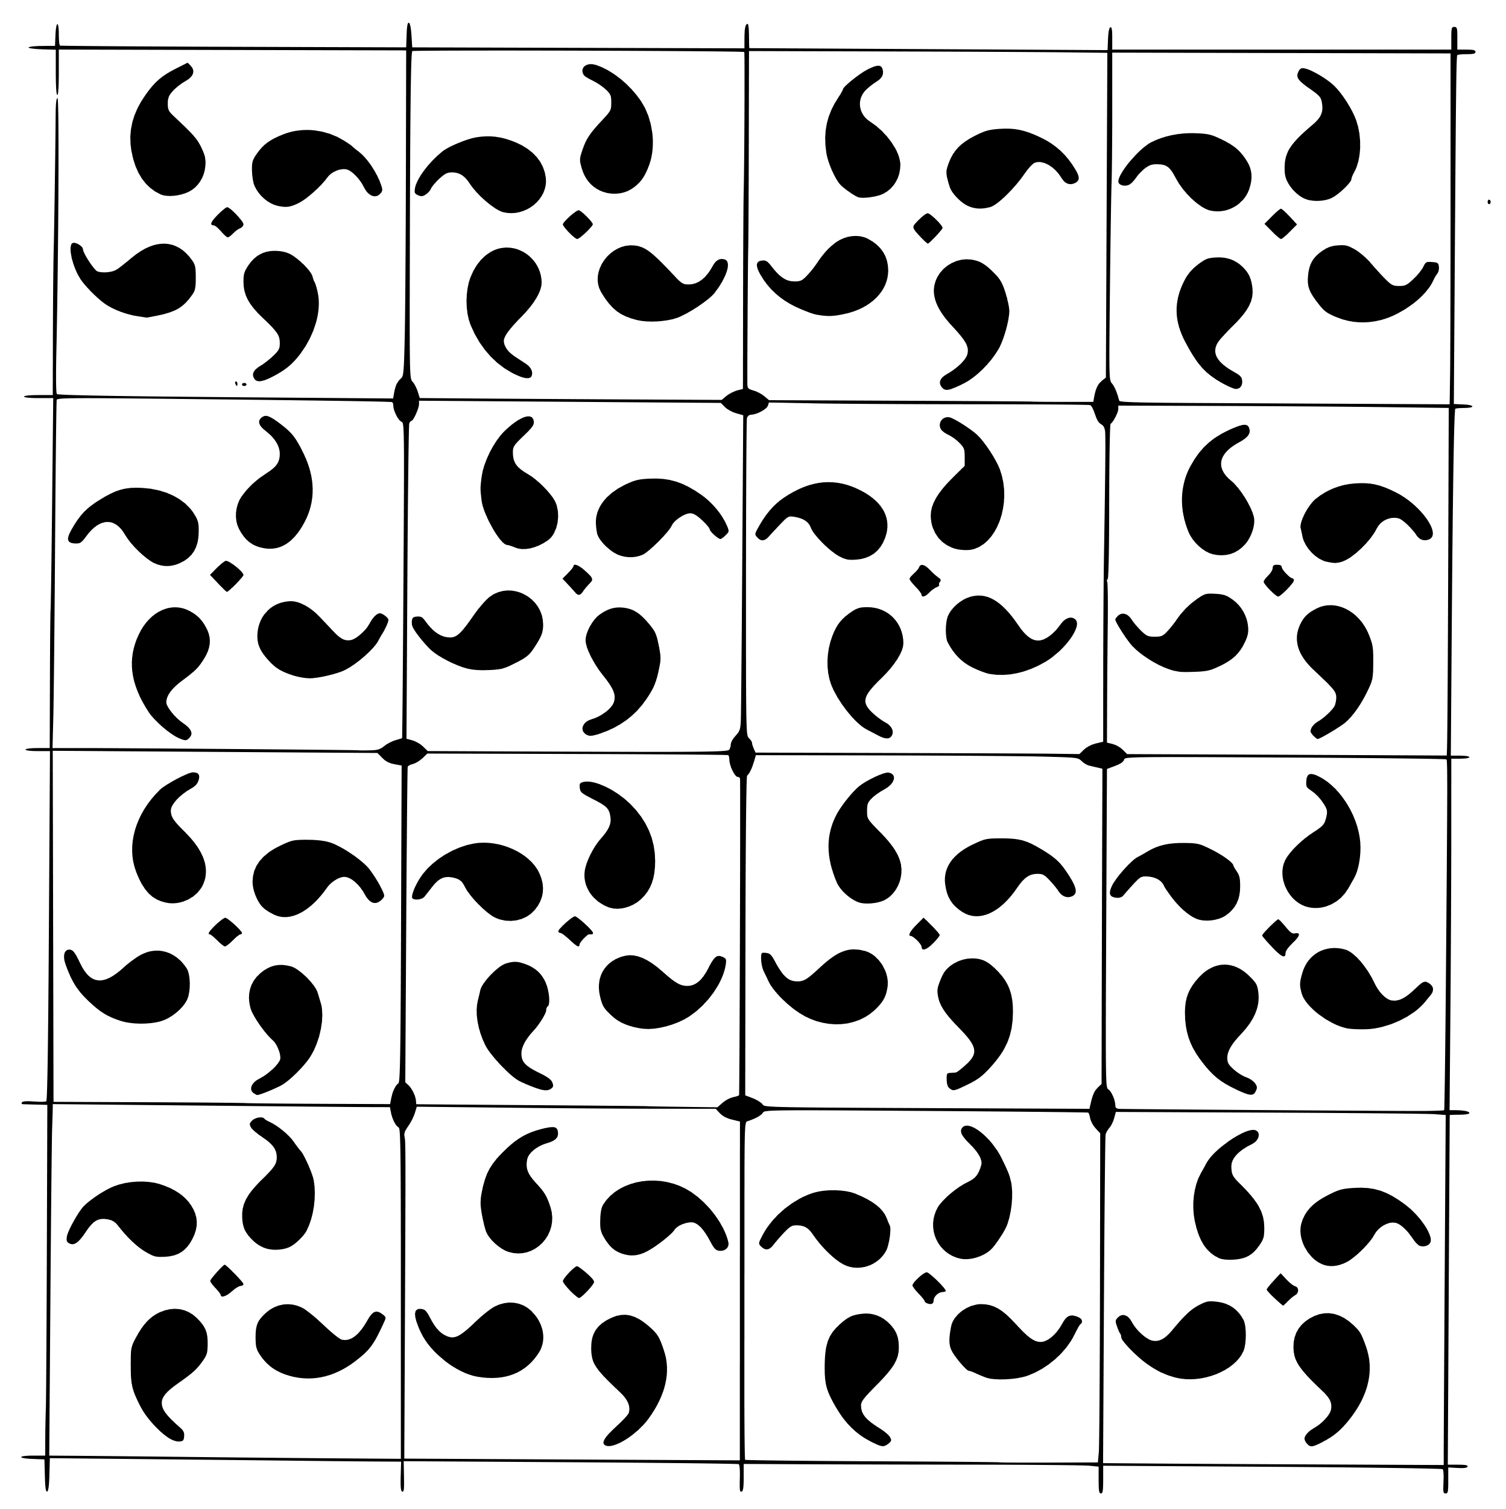
SQUARE
P4 P4MM P4GM
P4GM

Slide 20
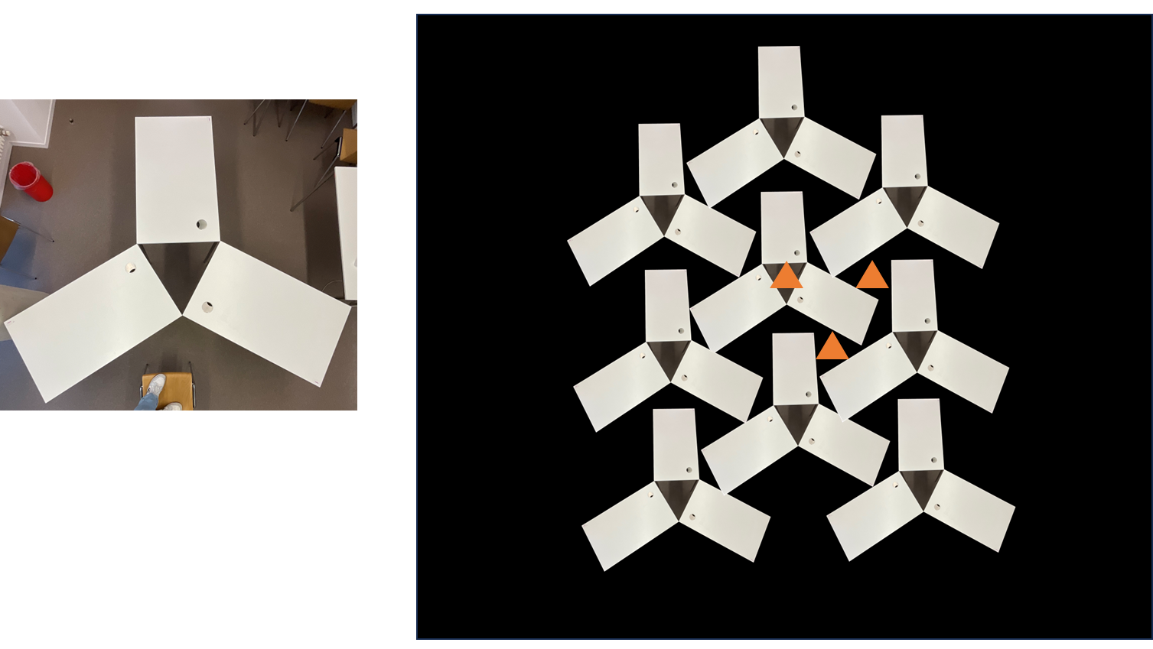
HEXAGONAL
P3 P3M1 P31M P6 P6MM
P3

Slide 21
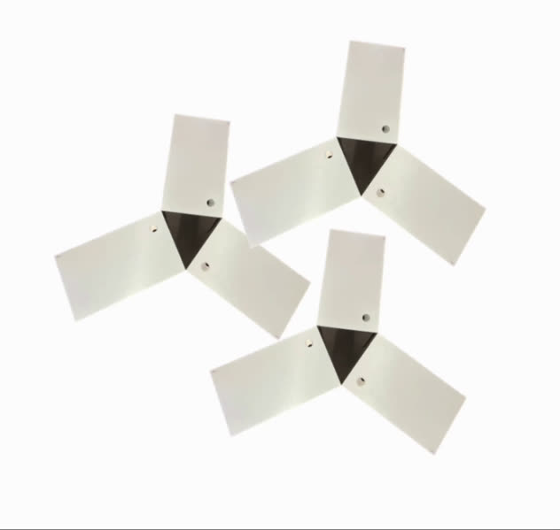
ANIMATION P3

Slide 22
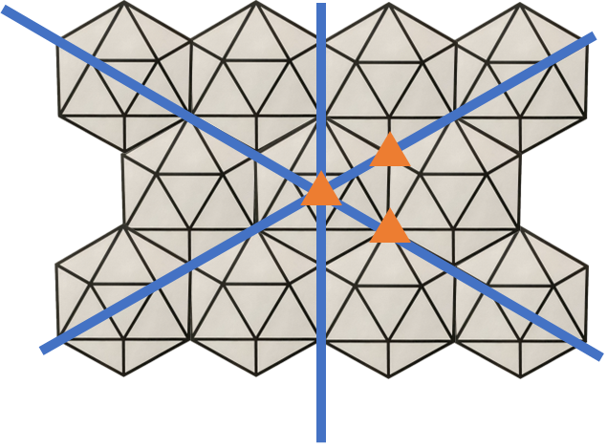
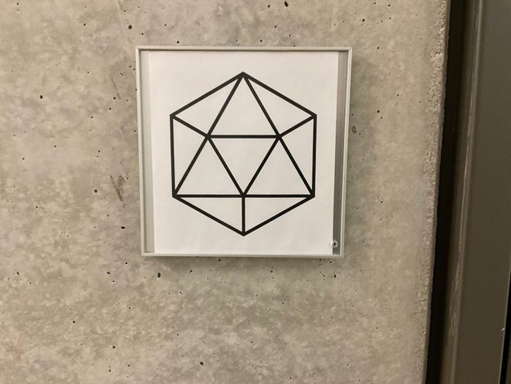
HEXAGONAL
P3 P3M1 P31M P6 P6MM
P3M1

Slide 23
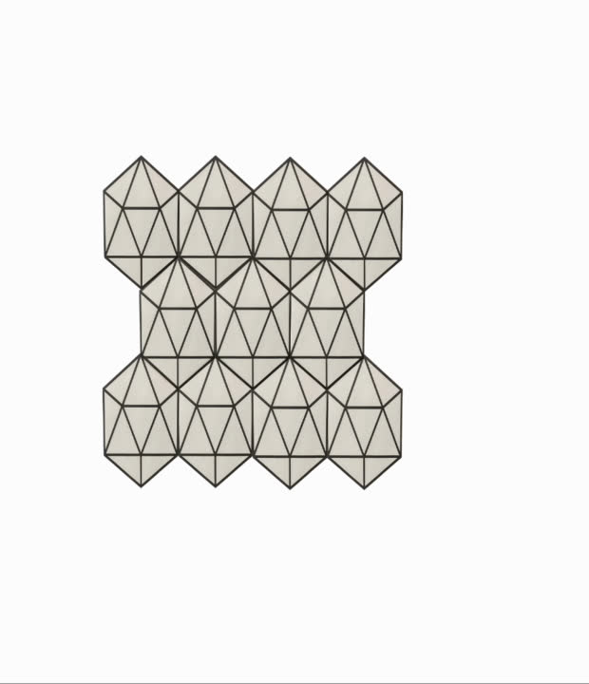
ANIMATION P3M1

Slide 24
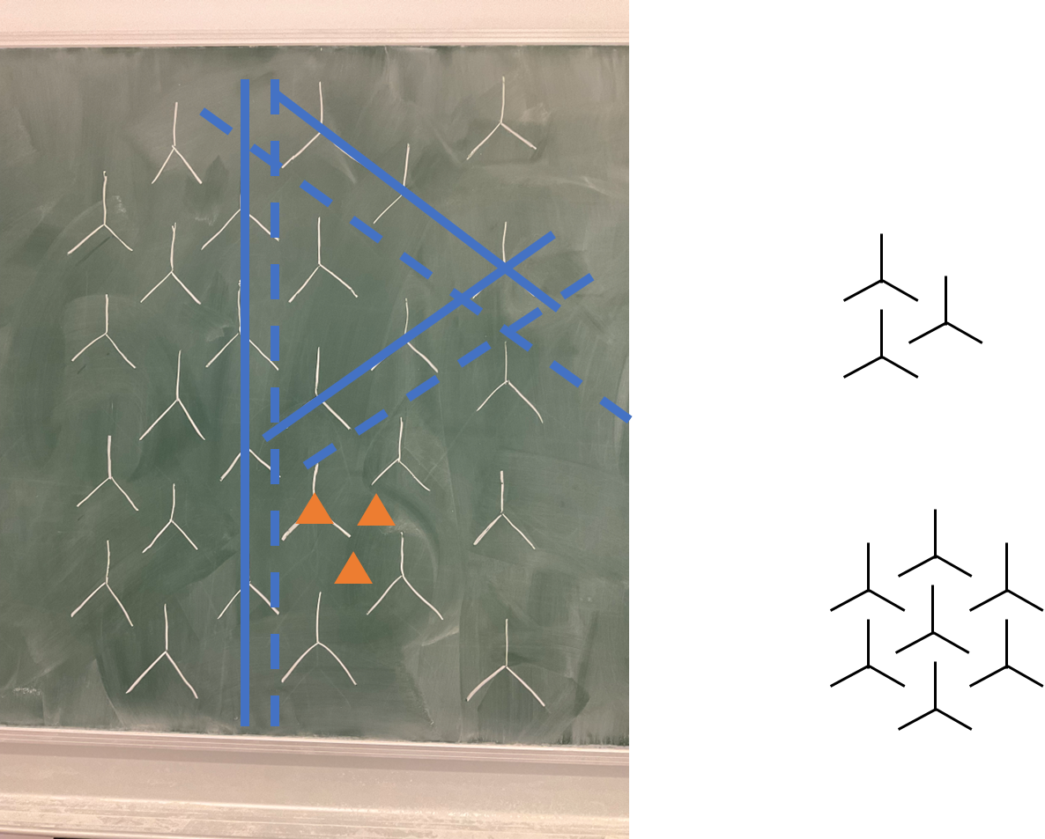
HEXAGONAL
P3 P3M1 P31M P6 P6MM
P31M

Slide 25
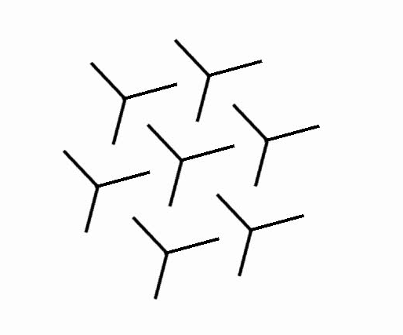
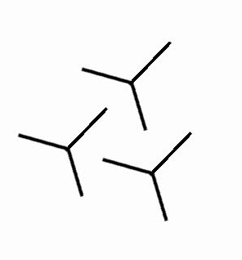
ANIMATION P31M

Slide 26
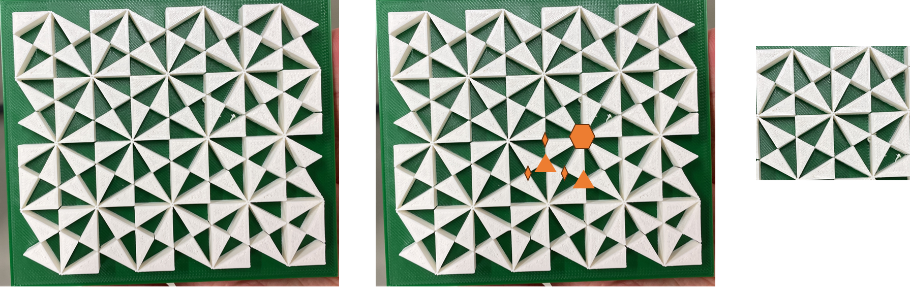
HEXAGONAL
P3 P3M1 P31M P6 P6MM
P6

Slide 27
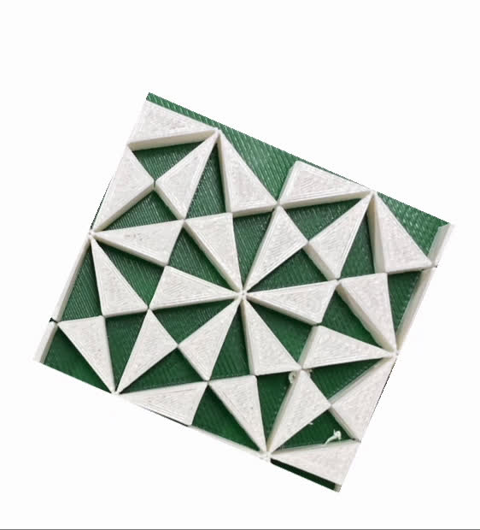
ANIMATION P6

Slide 28
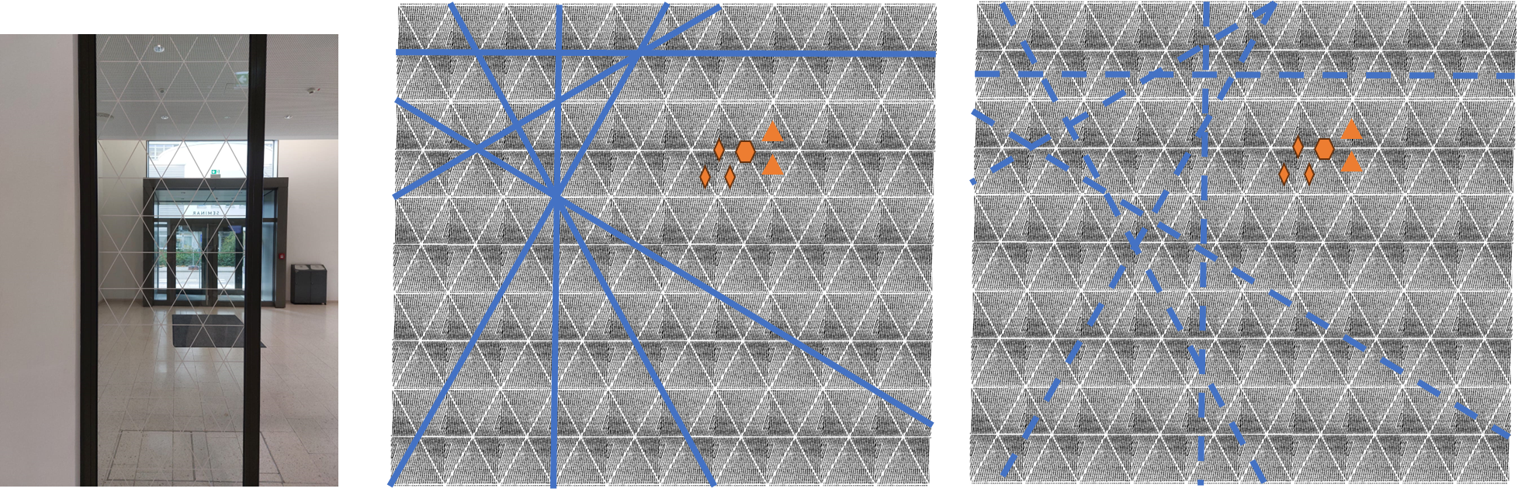
HEXAGONAL
P3 P3M1 P31M P6 P6MM
P6MM

Slide 29

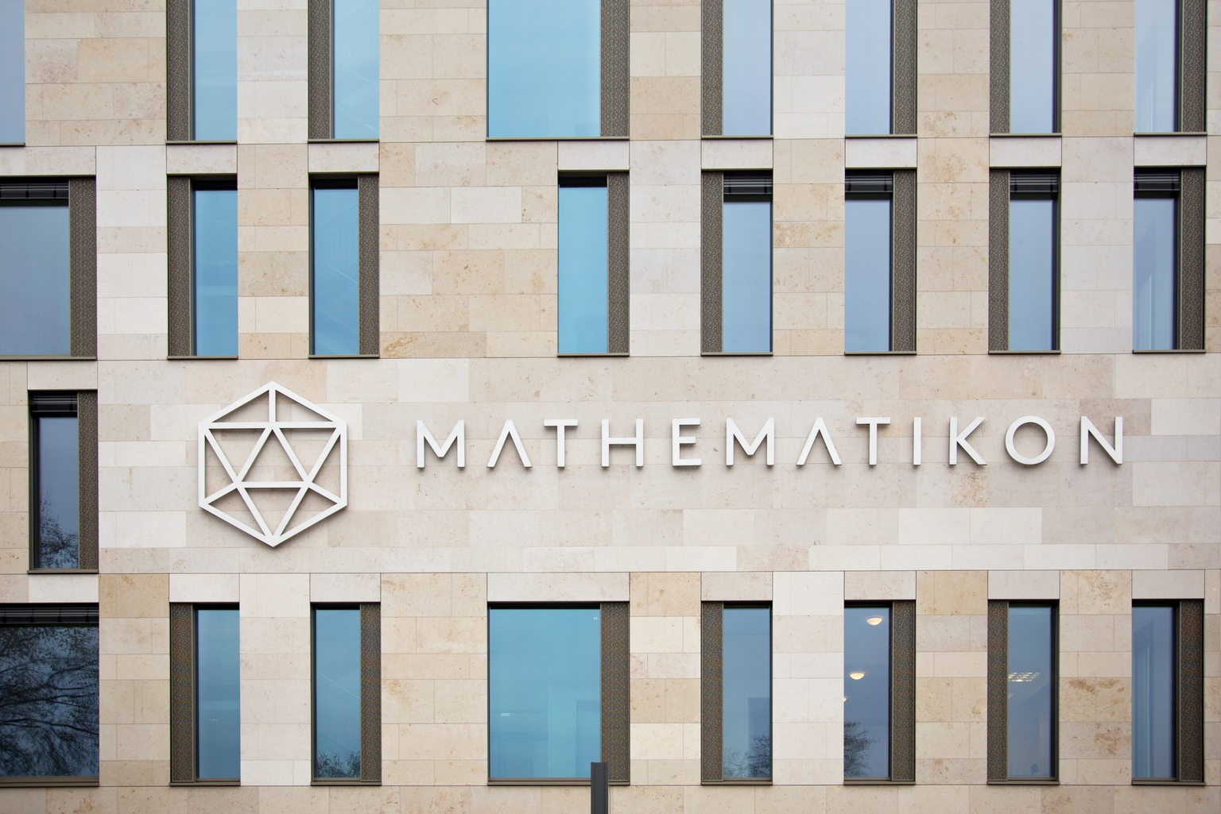


YES, THE MATHEMATIKON CAN DO BETTER!
  there’s no need to travel to Spain - just stay in Heidelberg & visit the Mathematikon
HEGL SEMINAR

Slide 30
SOURCES
Photos:
  Wallpaper group examples
    https://mathworld.wolfram.com/WallpaperGroups.html
  Alhambra:
    https://structures.uni-heidelberg.de/blog/posts/2023_01_palace_crystallographic/images/fig13.jpg
    https://upload.wikimedia.org/wikipedia/commons/d/de/Dawn_Charles_V_Palace_Alhambra_Granada_AndalusiaSpain.jpg
    https://structures.uni-heidelberg.de/blog/posts/2023_01_palace_crystallographic/images/fig12.jpg
  Mathematikon:
    https://www.katrinschacke.de/wp-content/uploads/2023/02/IM8A6649_logo-scaled.jpg
3D-files:
  https://www.york.ac.uk/depts/maths/histstat/symmetry/wallpapers.htm
P3M1 vs. P31M:
  https://tessellations.ca/2015/06/09/p31m-vs-p3m1/
Seminar literature:
  Armstrong, M. A., Groups and symmetry. Springer, New York (1988). https: //link.springer.com/book/10.1007/978-1-4757-4034-9

